Slide 1
Dormitory Management system
Prepared by
Ashfaqur Rahman Tokee 2022
Md. Shakil Hossain 2023
Mahabubur Rahman 2024
Nahidul Islam 2028

Slide 2
Project supervisor
FAHIMA TABASSUM
Professor
Institute of Information Technology
Jahangirnagar University

Slide 3
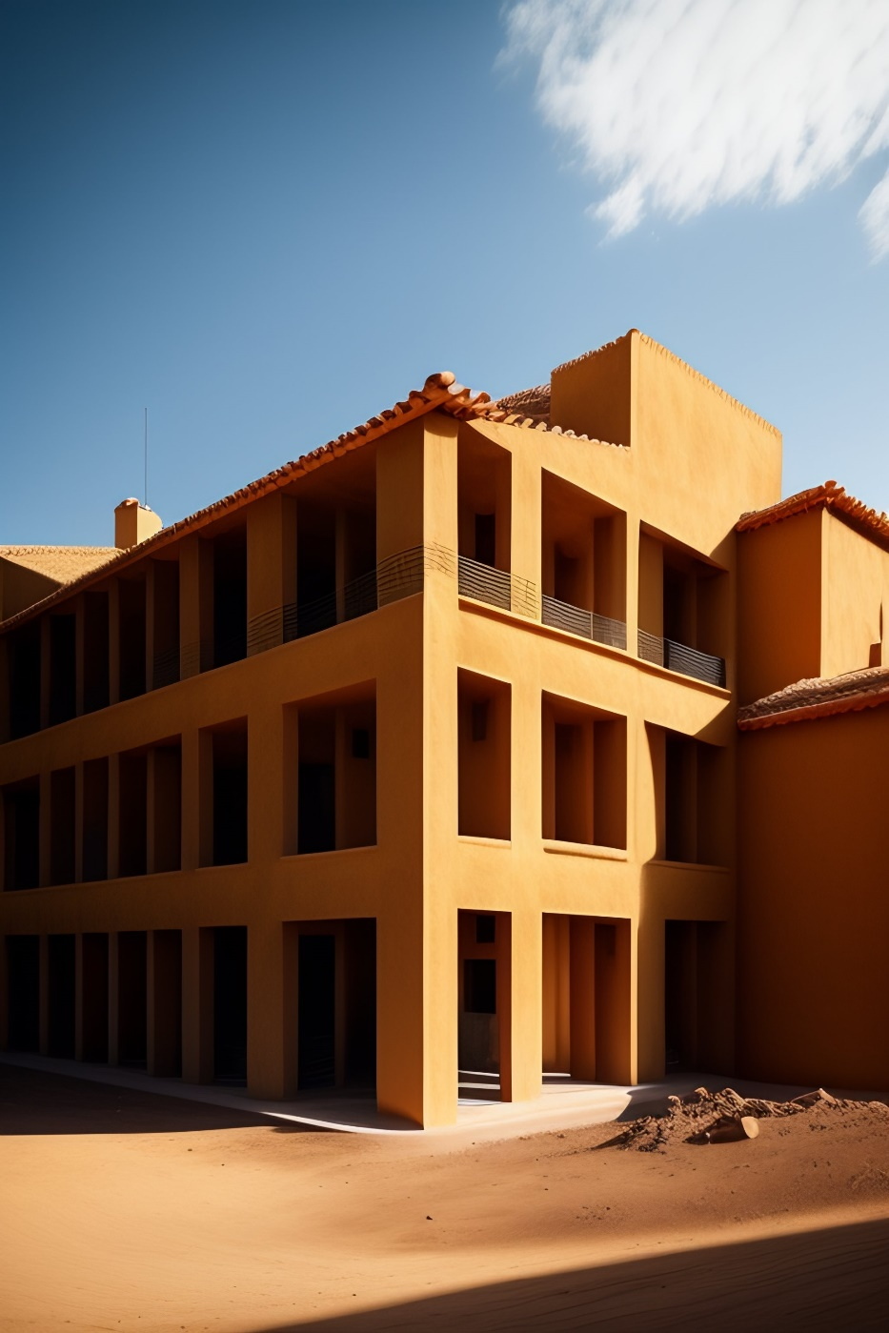
Introduction
Managing a university dormitory can be a complex and time-consuming task. With hundreds or even thousands of students to accommodate, it's crucial to have an efficient and reliable system in place to ensure that everything runs smoothly.
That's where the Dormitory Management System comes in. Our web-based platform provides a comprehensive set of tools to help administrators manage rooms, students, billing, complaints, and more, all in one place. By automating many of the routine tasks involved in dormitory management, we aim to make the process more efficient and less stressful for everyone involved.

Slide 4
objective
A web-based platform for managing a university dormitory
Features include room management, student registration, and complaint handling.
Room management allows administrators to view and manage room assignments, occupancy, and availability
Student registration provides an easy-to-use interface for students to register for accommodation and update their personal information
Provides accurate and up-to-date information on dormitory occupancy, room assignments, and billing and payment information.
Complaint handling provides a centralized platform for students to submit feedback or complaints and for administrators to manage and respond to them
The system aims to streamline and automate many of the routine tasks involved in dormitory management to make the process more efficient and less stressful for everyone involved.

Slide 5
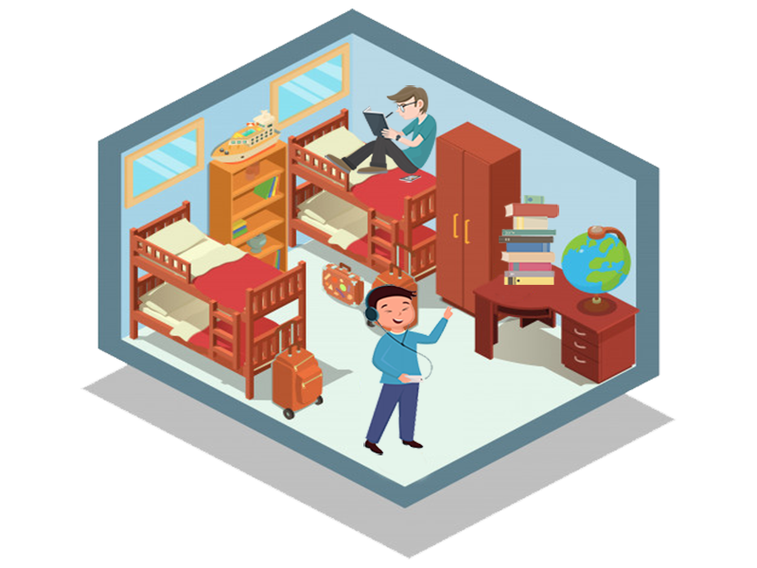
Benefits of dms
Benefits of using an online Dormitory Management System over traditional system.
Improves efficiency by automating routine tasks
Enhances communication and transparency between students and staff
Saves time for staff and improves the student experience
Provides better record-keeping and data-driven decision-making

Slide 6
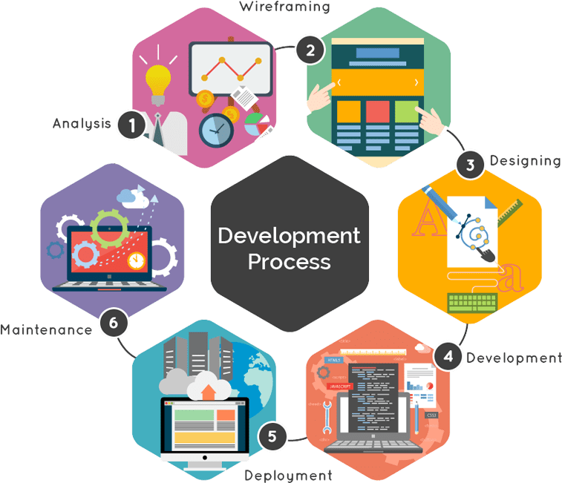
Development method
Used Agile development method
Emphasizes collaboration, flexibility, and adaptability
Iterative approach with continuous feedback and testing
Scrum framework used with regular sprint meetings, daily stand-ups, and retrospectives
Allows for flexibility in changing requirements or priorities.

Slide 7
System description
User classes
Admin: can manage dormitory rooms, billing, complaints, and generate reports
Student: can register, view bills, and submit complaints or feedback
Dormitory staff: Administrators and supervisors who manage room assignments, generate bills, respond to complaints or feedback, and communicate with students.
University management: Use the system to access reports and data on room occupancy, revenue, and expenses to make data-driven decisions about dormitory management.
Guest: has limited access to view general information.

Slide 8

System description
Operating Environment
Web-based application accessed through a browser
Compatible with popular browsers
Built with modern web technologies
Runs on a web server
Can be hosted on the cloud or on-premises

Slide 9
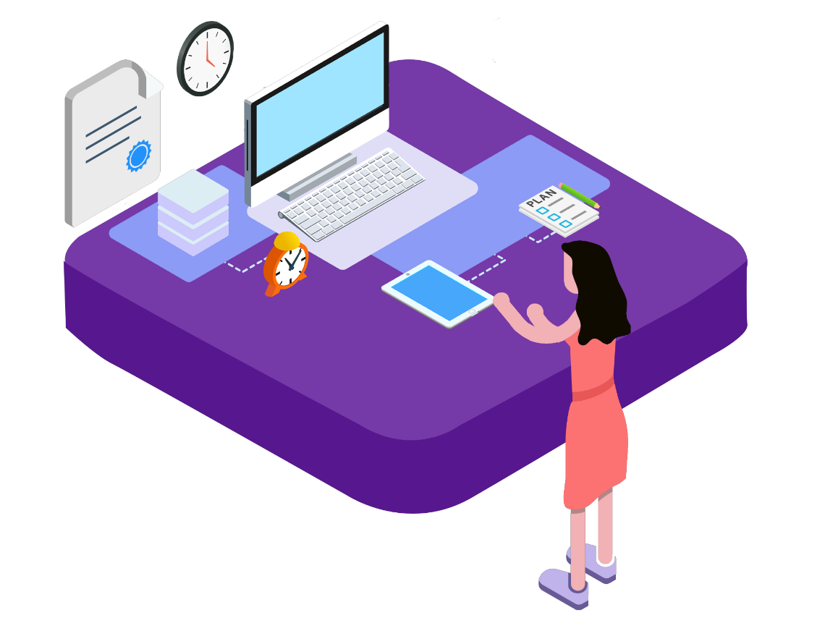
System description
User Environment
User-friendly and accessible interface
Different levels of access based on user roles
Intuitive navigation and labelling
Appropriate menus and functionality for each user class
Alerts, notifications, and reminders to keep users up-to-date.

Slide 10
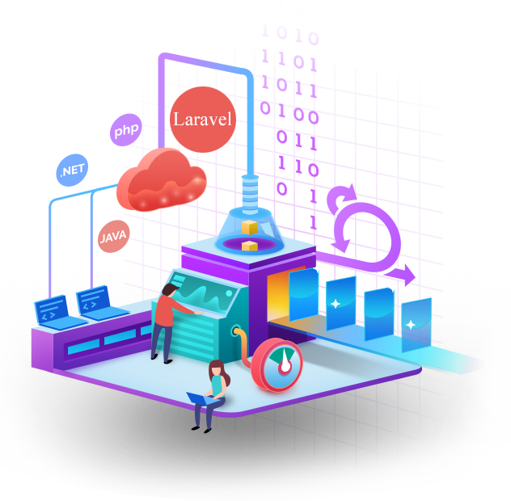
Implementation tools
Front End
HTML 5
CSS
Bootstrap4
JavaScript
Back End
PHP
MySQL

Slide 11
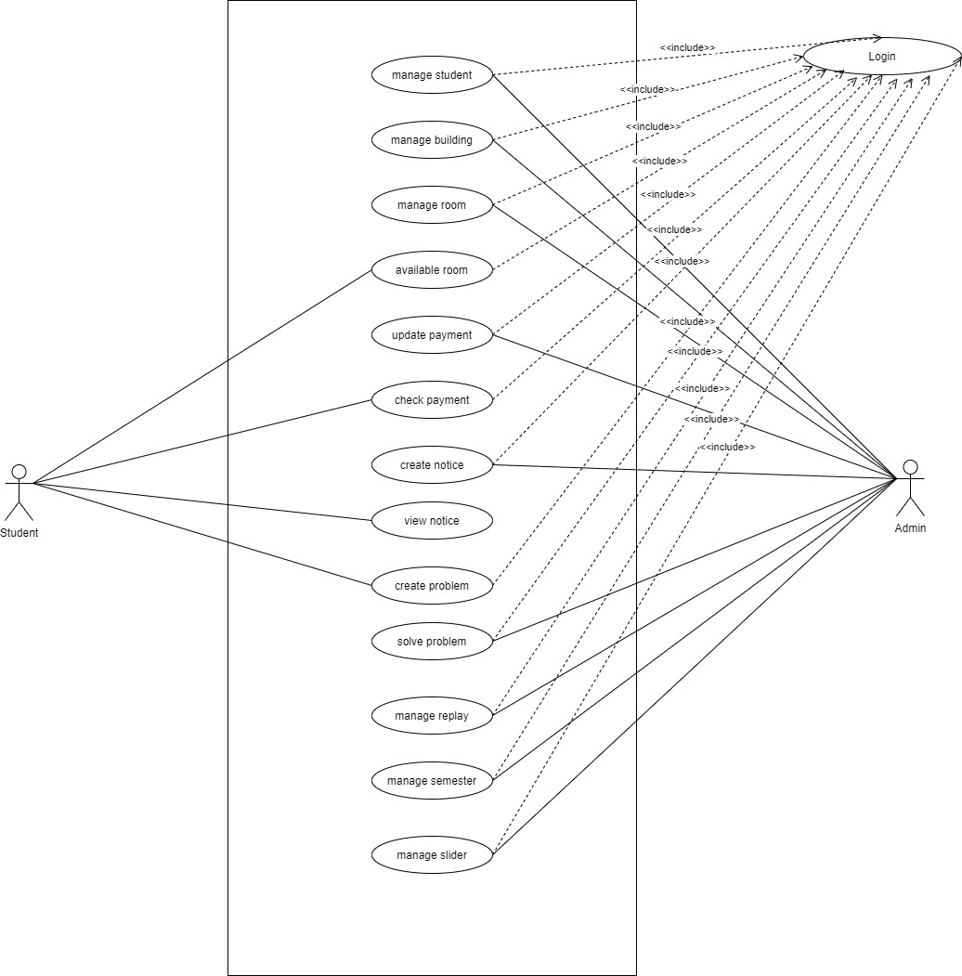
Use case diagram

Slide 12
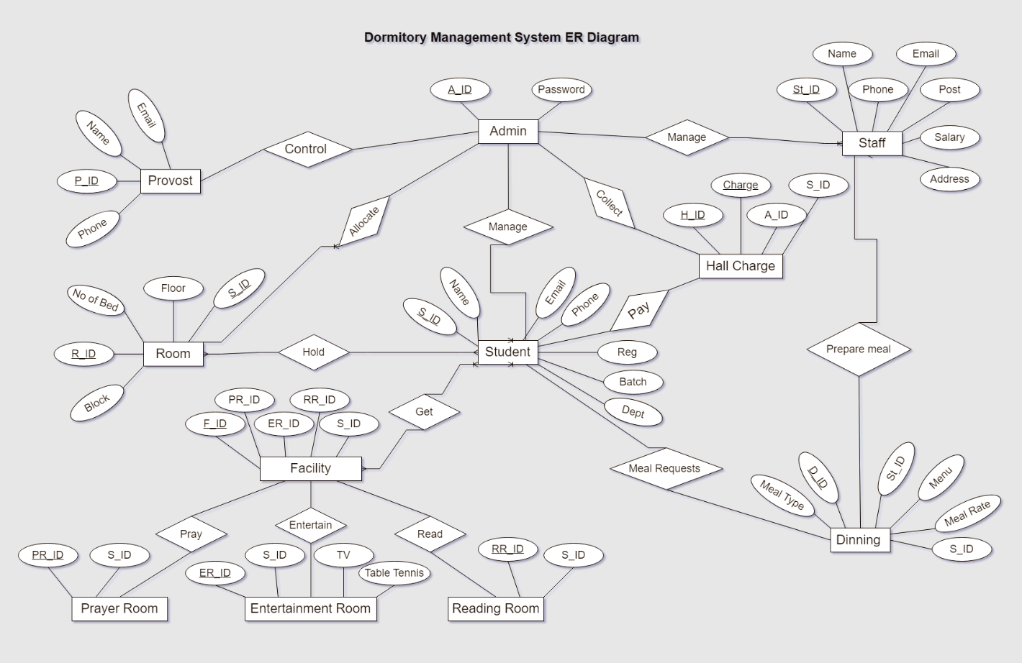
Entity relationship diagram

Slide 13
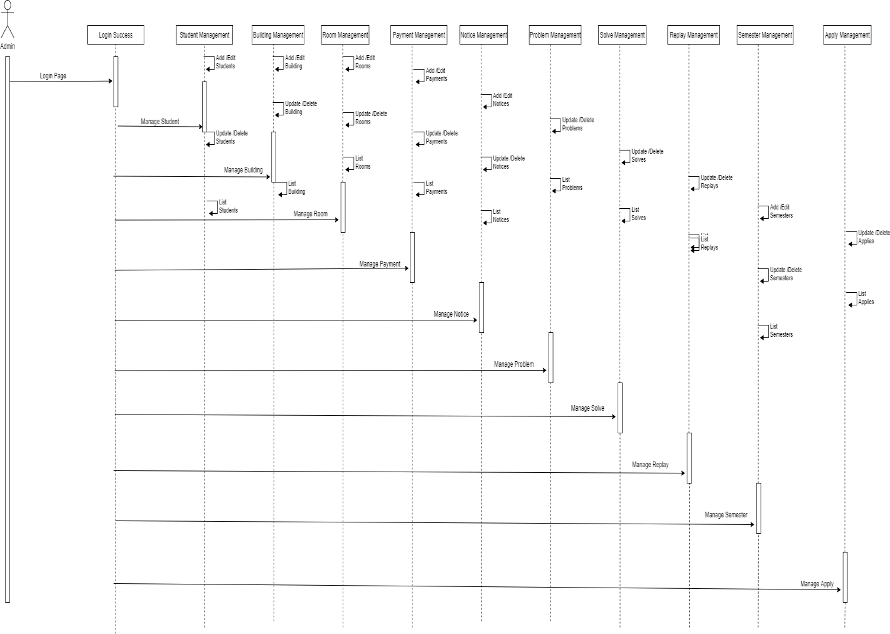
sequence diagram
Admin operation process

Slide 14
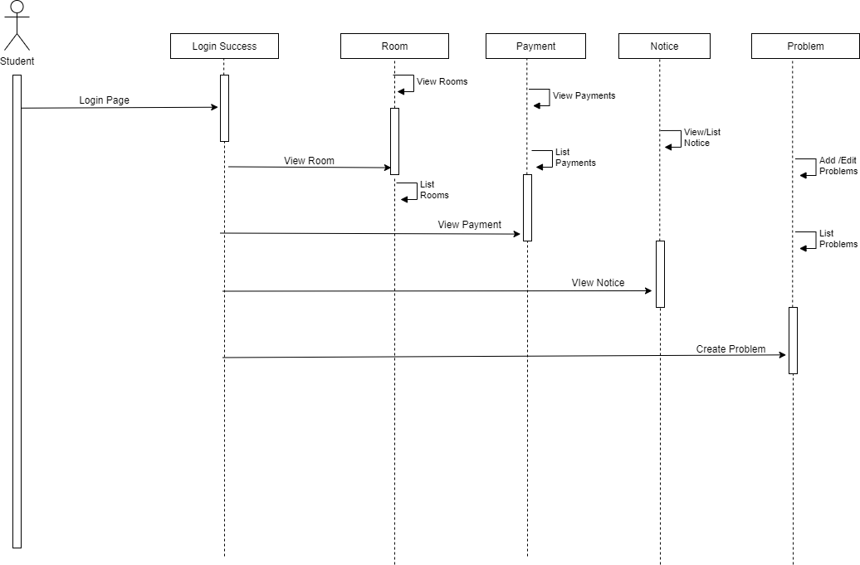
sequence diagram
student operation process

Slide 15
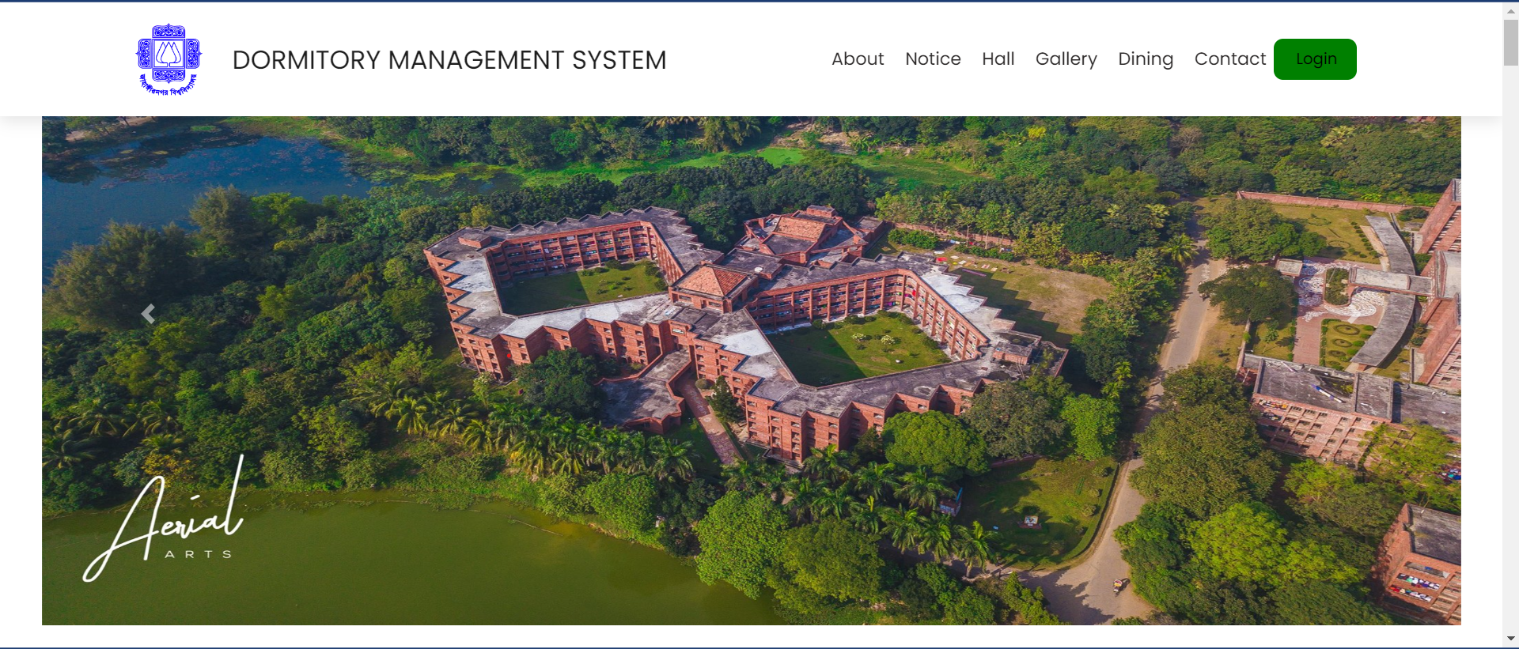
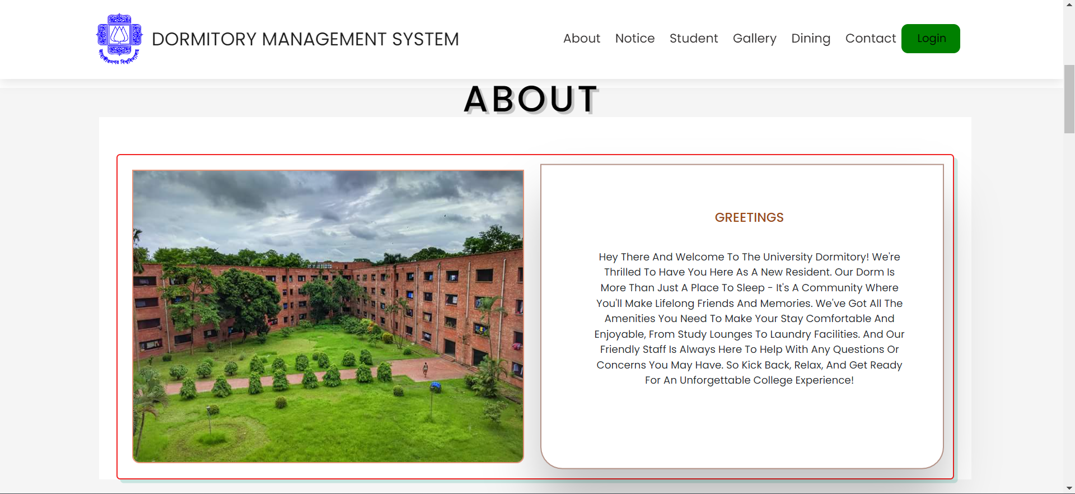
Modules and system interface
Homepage
About section

Slide 16
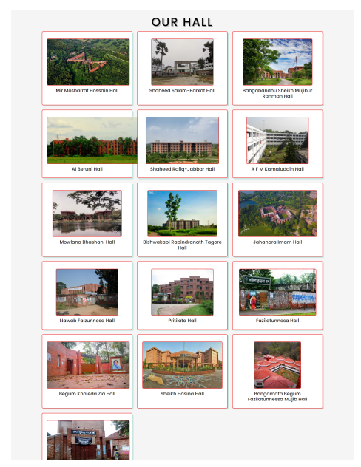
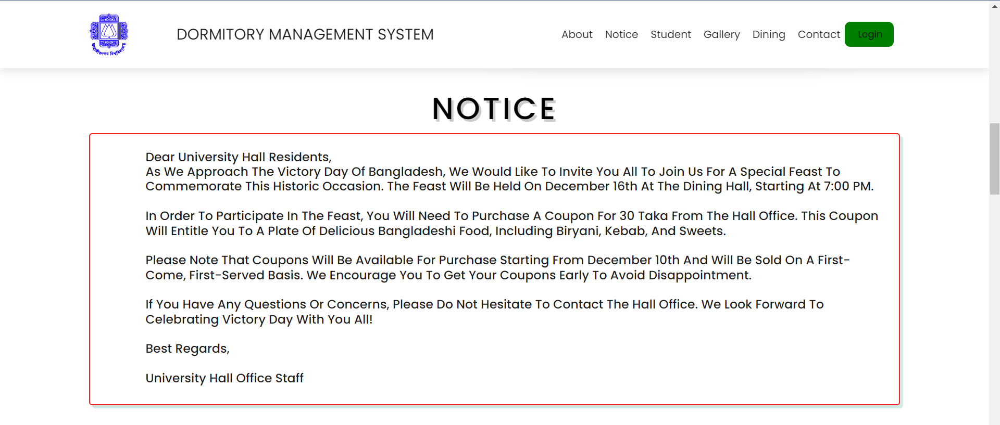
Modules and system interface
Hall list
notice

Slide 17
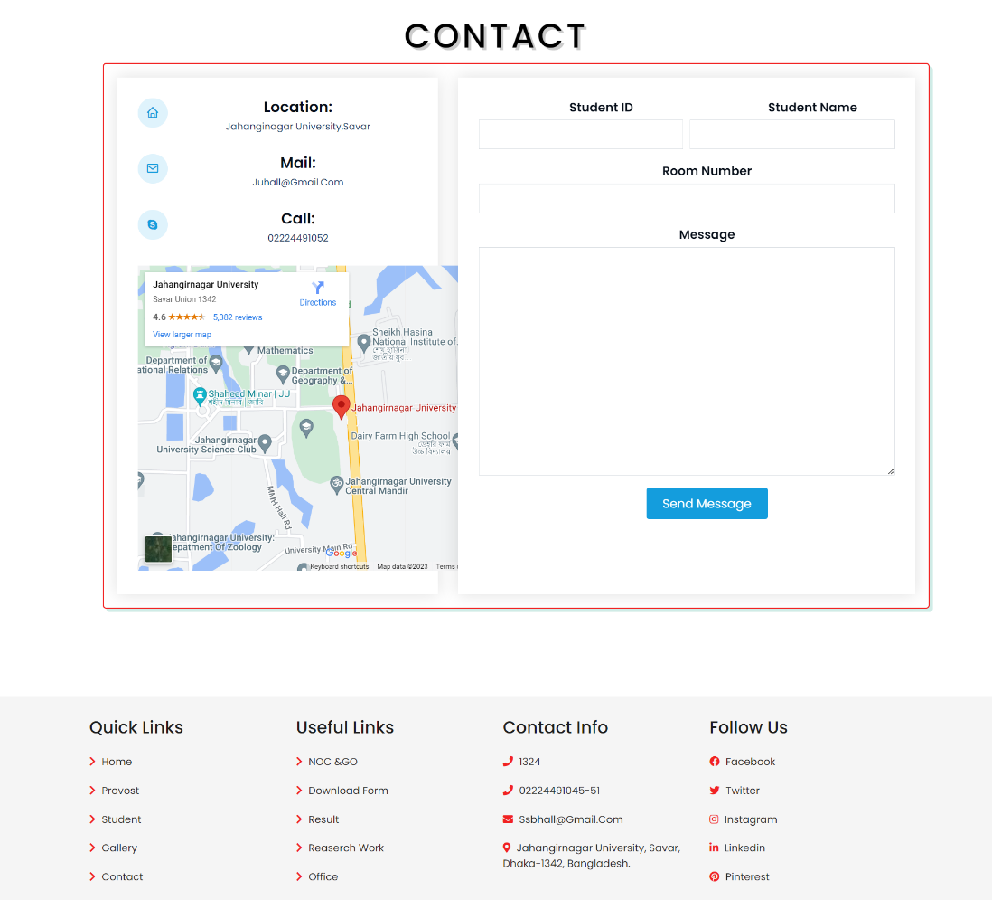
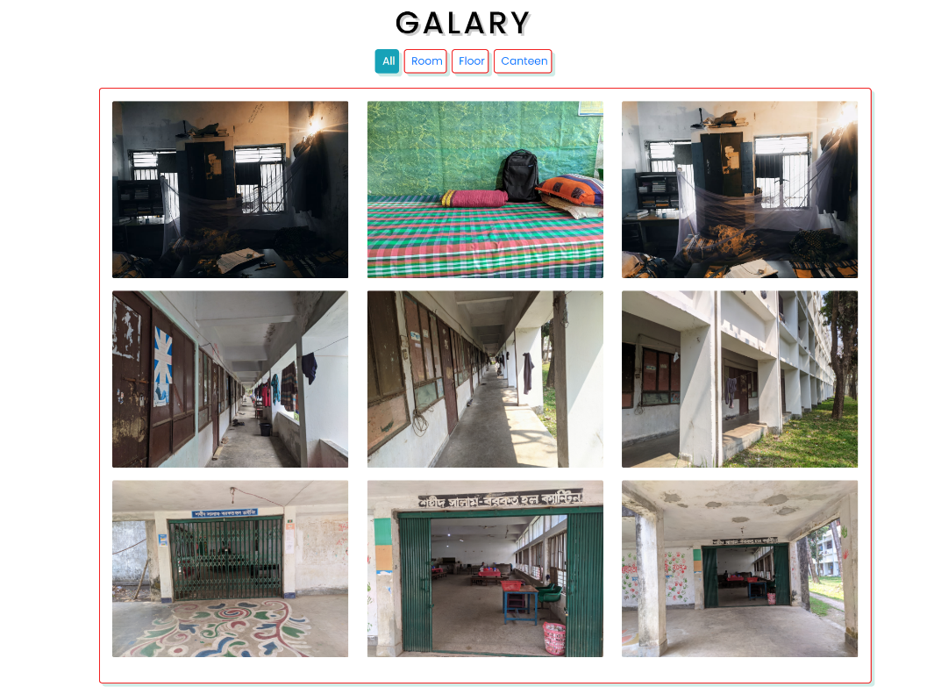
Modules and system interface
Contact and message
gallery

Slide 18
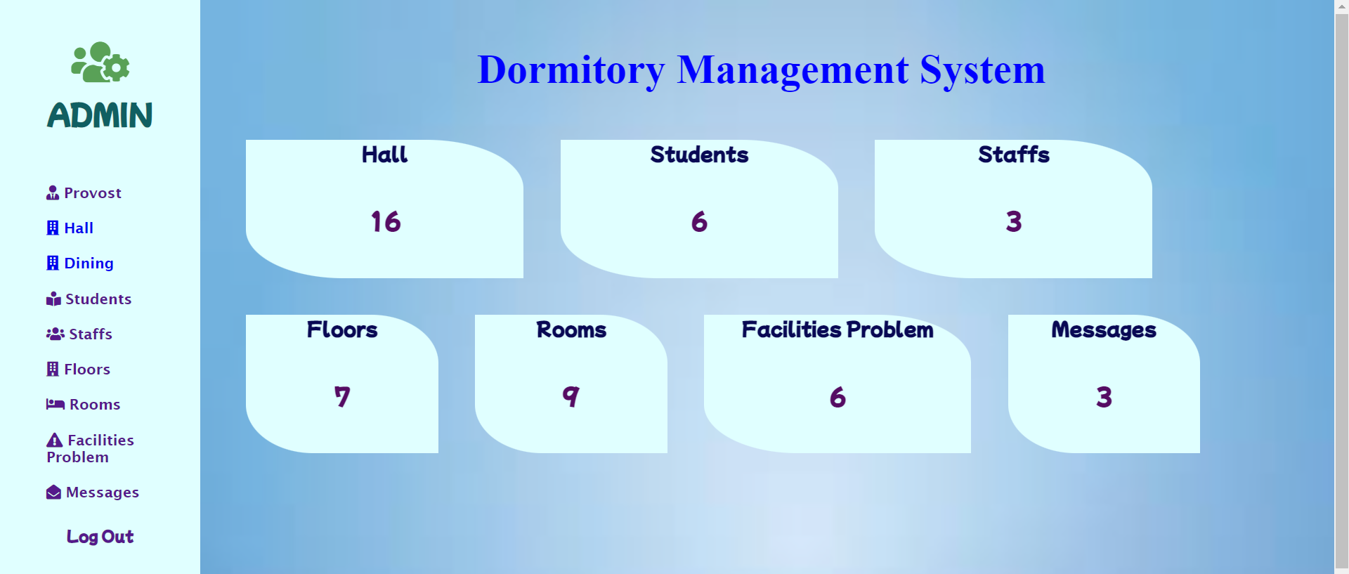
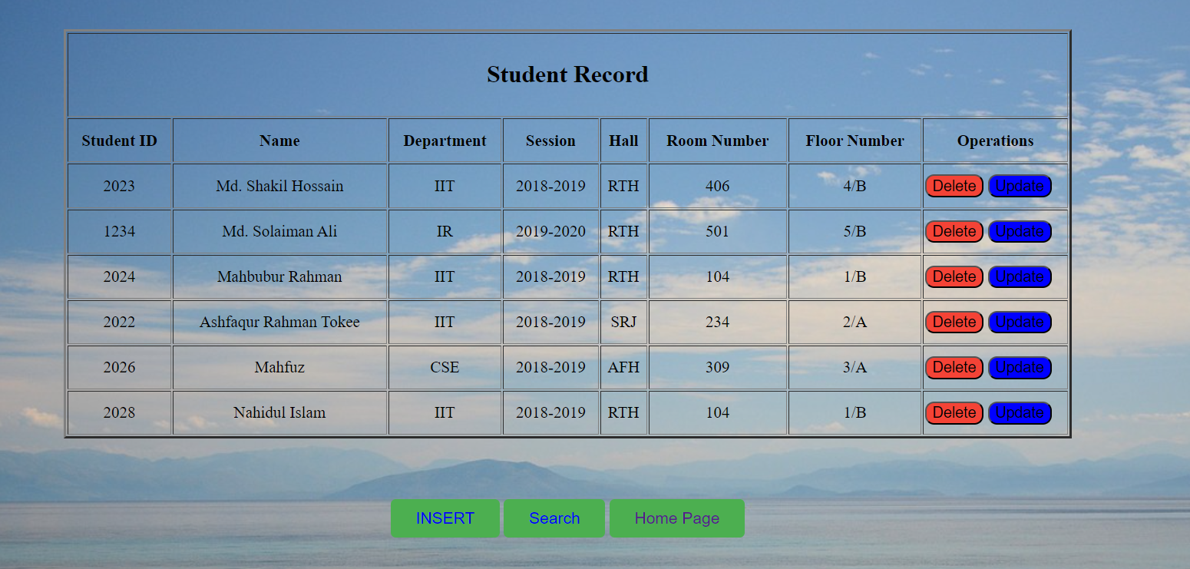
Modules and system interface
Admin dashboard
Student list

Slide 19
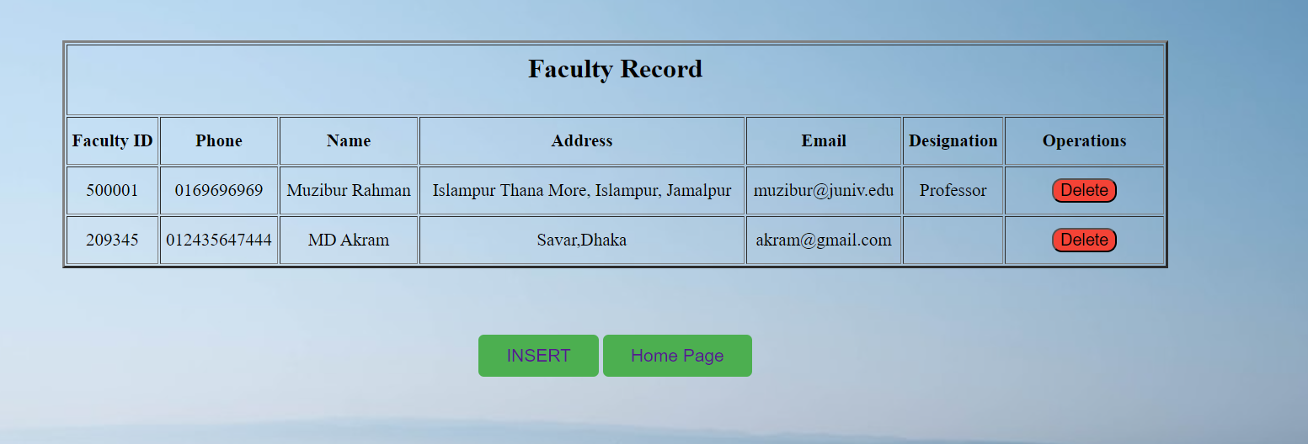
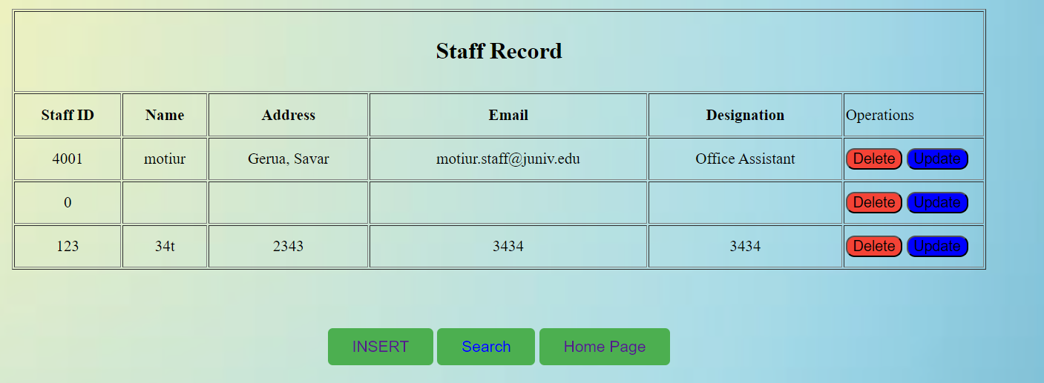
Modules and system interface
Faculty list
Staff list

Slide 20
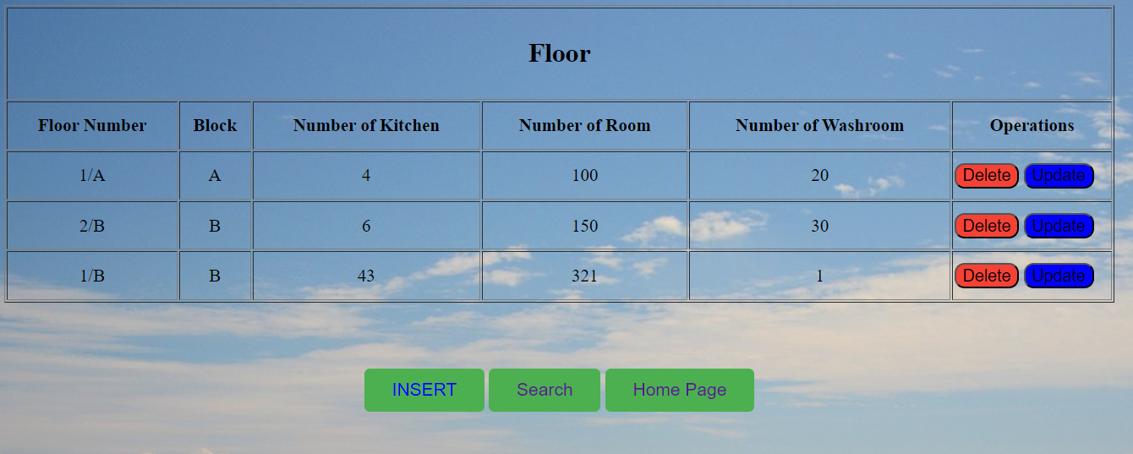
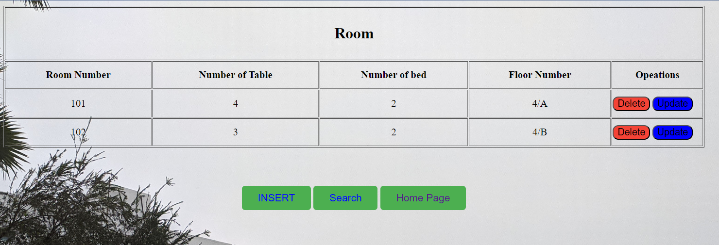
Modules and system interface
floors
Rooms information

Slide 21
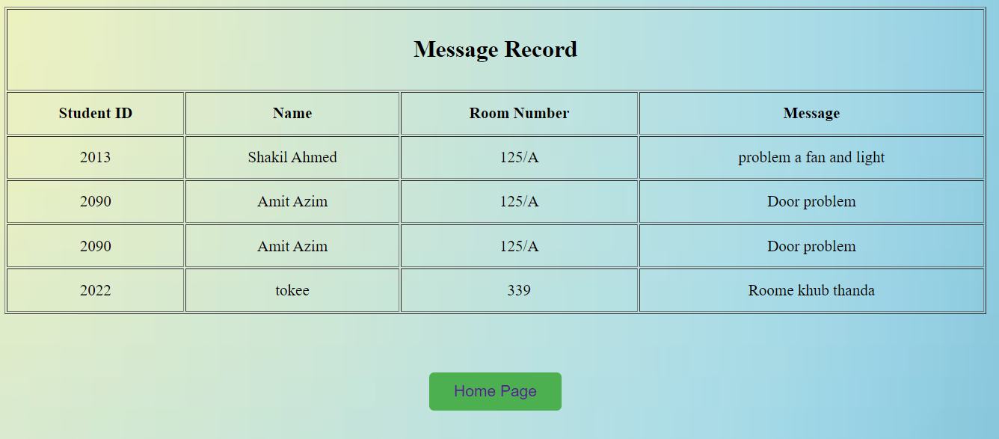
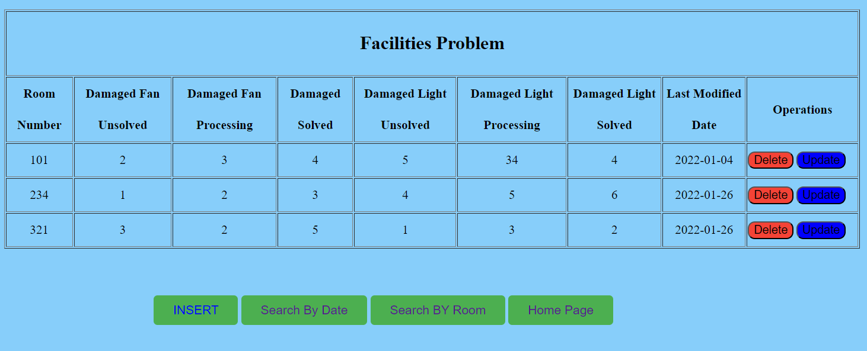
Modules and system interface
Message/complain
Problem evaluation

Slide 22
System limitations
The system may face technical challenges such as server crashes, system bugs, or internet connectivity issues.
Security risks such as hacking or data breaches are possible.
The system may require additional resources, such as hardware upgrades or additional staffing to ensure efficient and effective operation.
Future works
Integration with other systems for streamlined data flow.
Expansion to cover more dormitories or campuses.
Enhancements to user interface and experience.
Incorporation of advanced analytics and data visualization.
Exploration of new technologies such as AI, IoT, and blockchain.
Development of a mobile app for user convenience.

Slide 23
conclusion
the dormitory management system is a valuable tool for managing dormitories, improving efficiency, and providing a better user experience for students, staff, and administrators. While there are some limitations and opportunities for future work, the system's benefits and potential impact on dormitory management make it a worthwhile investment for universities and colleges. By using this system, universities can provide better living environments for their students and achieve better results in dormitory management.

Slide 24
Thank you

